Slide 1
Recreating Mosaic Requirement for Imbalance Reserves With Data Available in OASIS
Short-term Forecasting
shorttermforecasting@caiso.com
Rev: 12/11/2025

Slide 2
Outline
Introduction
How to recreate mosaic requirement with data available in OASIS
This will have a companion Excel spreadsheet
Recreating requirement for
Trade Date: 10/5/25
HE 15 (hour-ending 15)
‘DAM’ (Day-Ahead Market)

Slide 3
Introduction

Slide 4
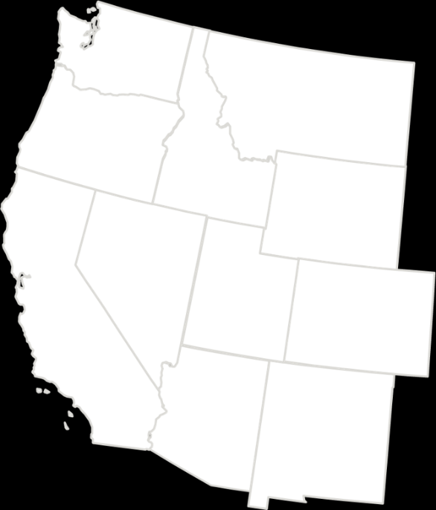
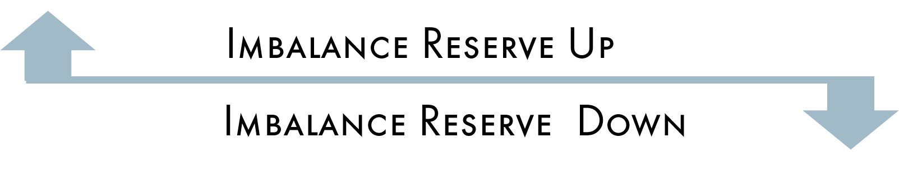
Imbalance Reserves (IR)
Imbalance reserve products provide the market with a mechanism to address each BAA’s expected range of uncertainty when comparing the day-ahead load forecast to real-time consumption and comparing solar and wind forecasts to their real-time outputs.
Procurement of reserves will be done on an hourly basis for each BA from the bids that are submitted by SCs across the EDAM footprint.
SCs submit bids for imbalance reserve up and imbalance reserve down and may receive hourly awards for one or both products.
Notes:
Range of uncertainty:
These imbalances are caused by uncertainty in the day-ahead net load forecast and granularity differences between day-ahead hourly forecasts and real-time fifteen-minute forecasts.

Slide 5
Mosaic
Define Uncertainty: DAM Uncertainty (RTPD binding – DAM)
D = Demand Uncertainty *
W = Wind Uncertainty
S = Solar Uncertainty
ND = Net-Demand Uncertainty
Define “histogram” for components: D,S,W
D_{h} = c_{d}
W_{h} = c_{w}
S_{h} = c_{s}
Define quantile regression model for components: D,S,W
D_{q} = c_{d} + b_{d}*mosaic + a_{d} * mosaic^{2 **}
W_{q} = c_{w} + b_{w}*mosaic + a_{w} * mosaic²
S_{q} = c_{s} + b_{s}*mosaic + a_{s} * mosaic²
Construct mosaic variable:
mosaic = ND_{h} + (D_{q} – D_{h} ) - (W_{q} – W_{h} ) - (S_{q} – S_{h})
Define final Net-Demand Uncertainty model:
ND_{M} = c_{m} + b_{m}*mosaic + a_{m} * mosaic²
Stage 1
Component-level quantile regression
Stage 2
Net-demand-level quantile regression
Equations taken from Original White Paper
*Demand is referred to as Load
** a,c are flipped in OASIS vs. how the equations are specified in this paper. Companion spreadsheet matches OASIS.

Slide 6
Mosaic (cont’d) – Applying thresholds
Define dynamic “threshold” for net Net-Demand: ND
ND_{dt} = c_{nd1}
Define static ceiling “threshold” for Net-Demand: ND
ND_{ct} = c_{nd2}
Define static floor “threshold” for Net-Demand : ND
ND_{ft} = c_{nd3}
Define final Net-Demand Uncertainty model:
ND_{M} = c_{m} + b_{m}*mosaic + a_{m} * mosaic²
Apply Threshold :
Down = MIN( MAX( ND_{Mdown}, ND_{dtdown}, ND_{ctdown}), ND_{ftdown})
Up = MAX( MIN( ND_{Mup}, ND_{dtup}, ND_{ctup}), ND_{ftup})
Stage 2 (cont.)
To ensure the CAISO does not set extreme requirements, the CAISO enforces 2 layers of thresholds to bound the IRU/IRD requirements, dynamic and static thresholds. Dynamic thresholds are updated daily and currently reflect the 1%,99%. The CAISO will evaluate these static thresholds every quarter, or as needed with changing weather conditions. To the extent permissible, the CAISO will provide EDAM entities a week’s notice prior to making any changes to the Max thresholds. Both sets of thresholds are posted publicly to OASIS.

Slide 7
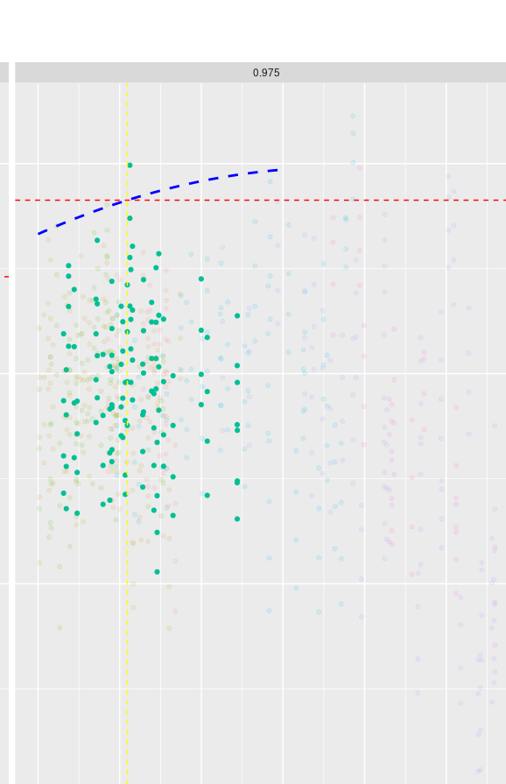
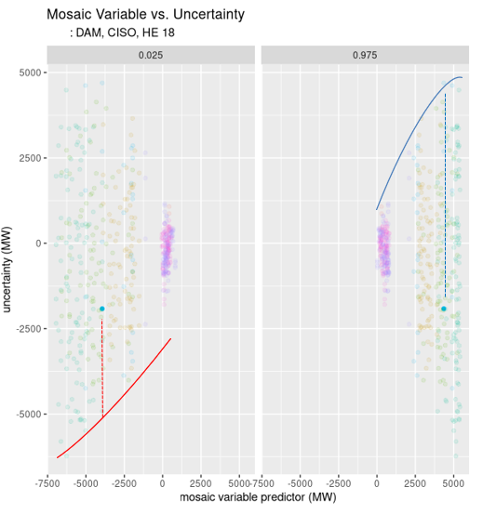
Mosaic (cont’d) – Graphical depiction
Stage 1 – Component Level Quantile Regression (showing just demand as example)
Stage 2 – Net-Demand Level Quantile Regression
Note, this are illustrative examples – not directly tied to 10/5/25 trade date, HE 15

Slide 8
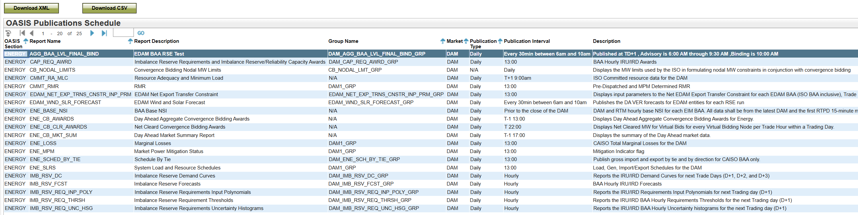
Open-Access Same-Time Information System (OASIS) provides a publications schedule of reports
OASIS > Atlas Reference > Publications > OASIS Publications Schedule Market = DAM
OASIS Section = Energy
*Reports not currently available in Stage and Production OASIS – results may be intermittent during market sim*

Slide 9
Recreating Mosaic Requirement

Slide 10
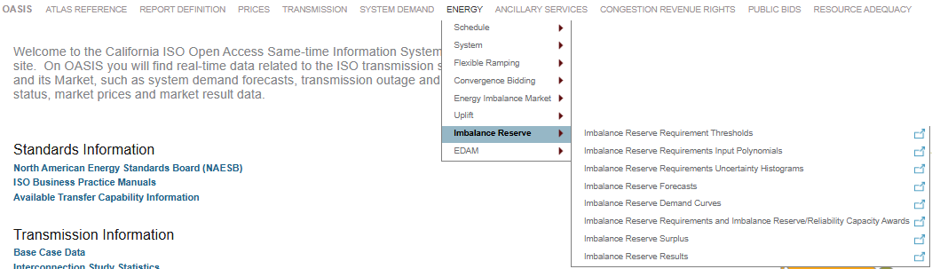
3 Steps to Recreate Mosaic Requirement
Gather Relevant Information from OASIS
Perform two stages of calculations in line with the BRS
Validate IR calculation with report in OASIS
All reports discussed the rest of presentation will be within
OASIS > Energy > Imbalance Reserve
OASIS > Energy > Flexible Ramping

Slide 11
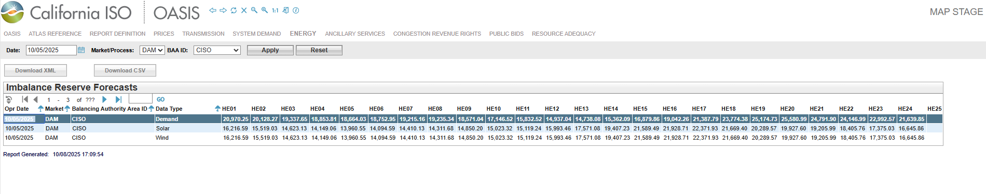

GRAB INPUT FORECASTS Market/Process= ‘DAM’ HE15
OASIS > Energy > Imbalance Reserve > Imbalance Reserve Forecasts
Wind: 918
Solar: 15347
*Due to defect in MAP Stage OASIS, not ready for replication – will be resolved in coming weeks

Slide 12
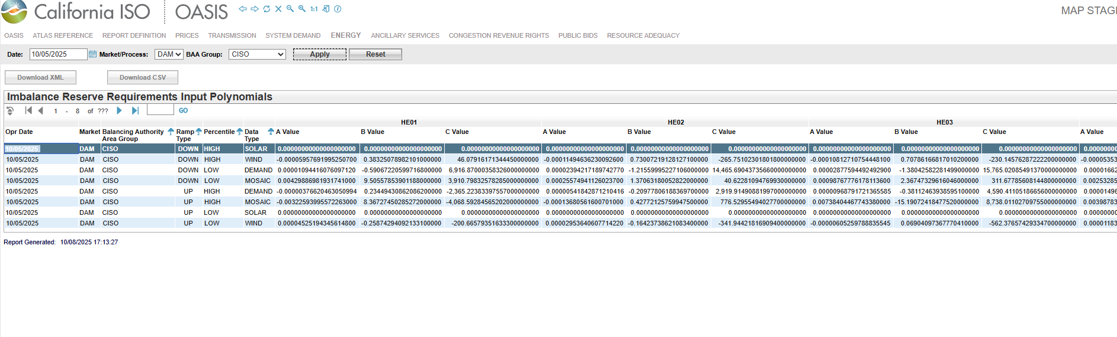
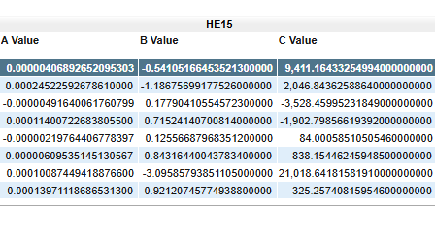
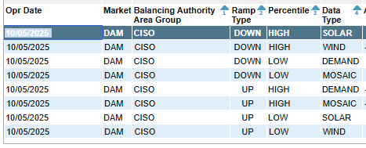
GRAB INPUT POLYNOMIALS Market/Process= ‘DAM’ HE15 Ignore Percentile
OASIS > Energy > Imbalance Reserve > Imbalance Reserve Requirements Input Polynomials

Slide 13
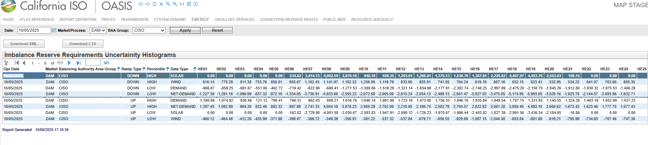

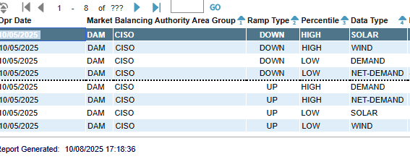
GRAB Histogram VALUES Market/Process= ‘DAM’ HE15 Ignore Percentile
OASIS > Energy > Imbalance Reserve > Imbalance Reserve Requirements Uncertainty Histograms

Slide 14
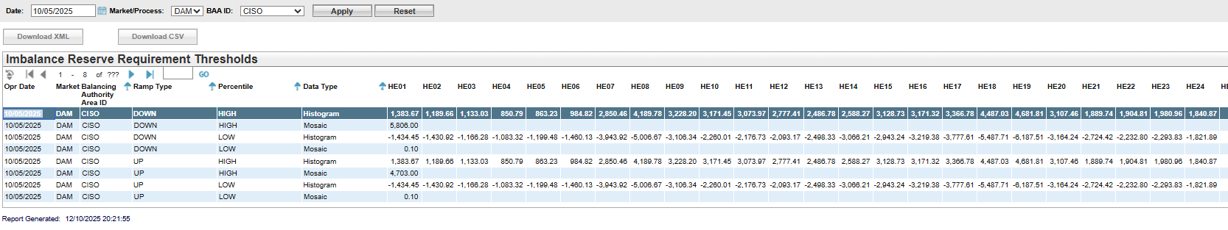

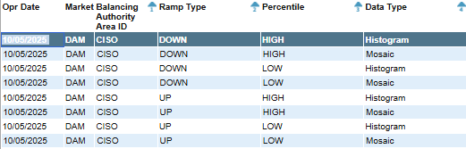

GRAB Threshold VALUES Market/Process= ‘DAM’ HE15 Ignore Percentile
OASIS > Energy > Imbalance Reserve > Imbalance Reserve Requirement Thresholds
PLACEHOLDER – HOW TO NAVIGATE TO THIS REORT
Use HE1 for mosaic threshold
Mosaic threshold = Static Threshold and is the same for all hours

Slide 15
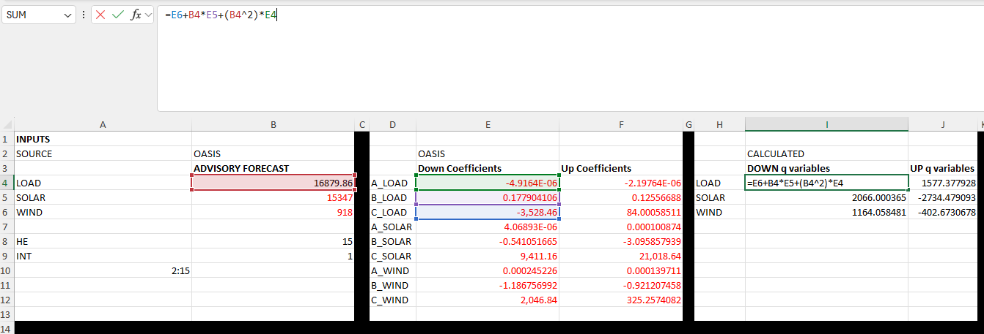
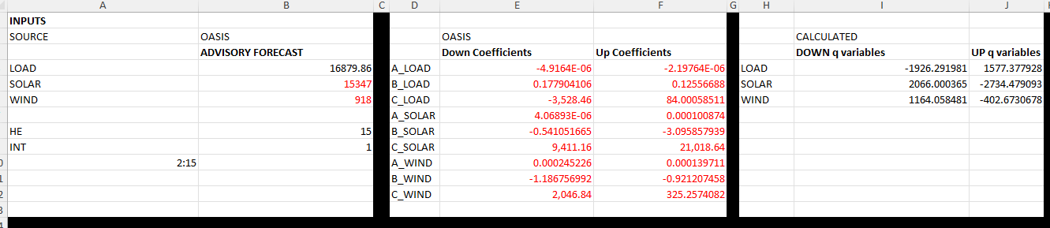
(Stage 1) Calculate “q” variable for load, solar and wind, using input forecasts and polynomial coefficients

Slide 16
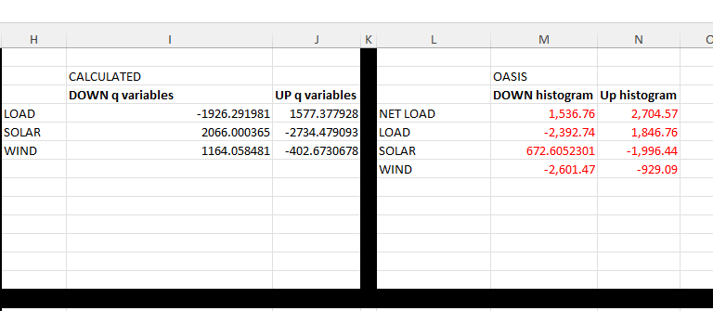
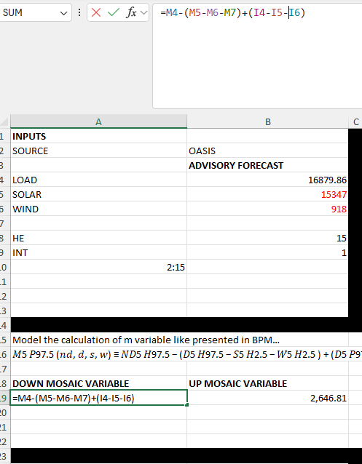
(Stage 2) Calculate “m” variable for net load, using histograms and “q” variables

Slide 17
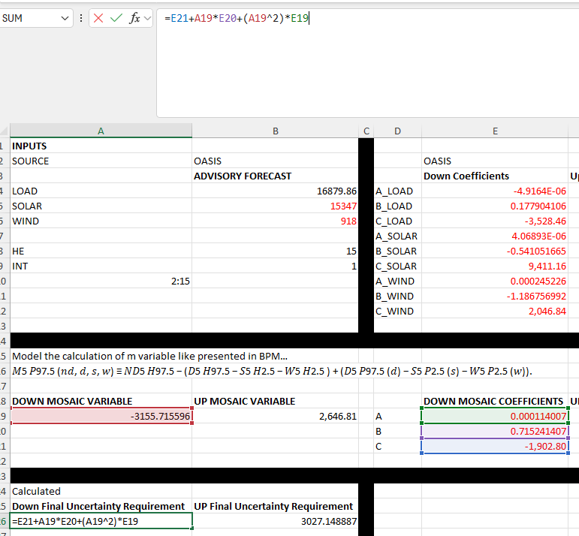
(Stage 2 cont.) Calculate Mosaic Net Load requirement, using “m” variables and polynomial coefficients

Slide 18
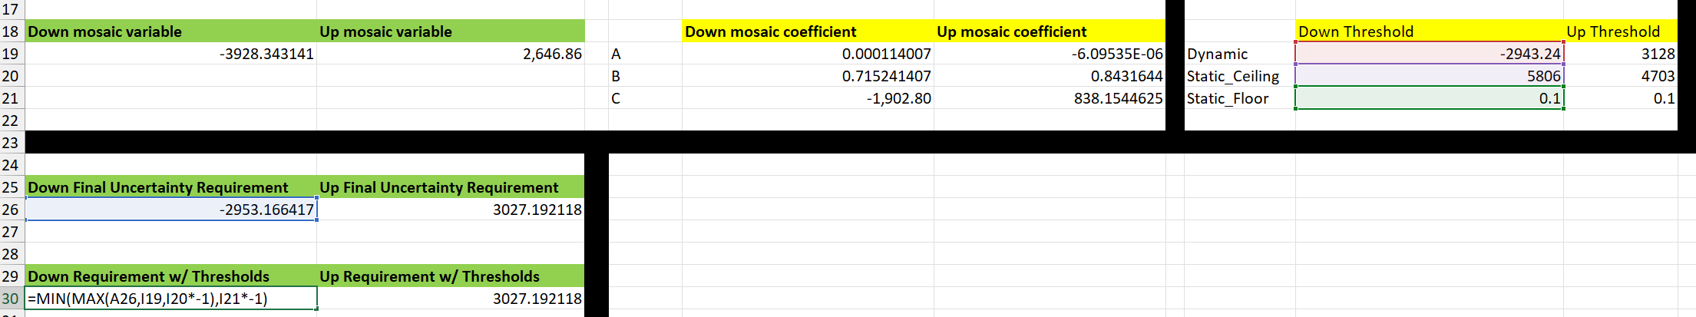
(Stage 2 cont.) Apply Static and Dynamic thresholds

Slide 19
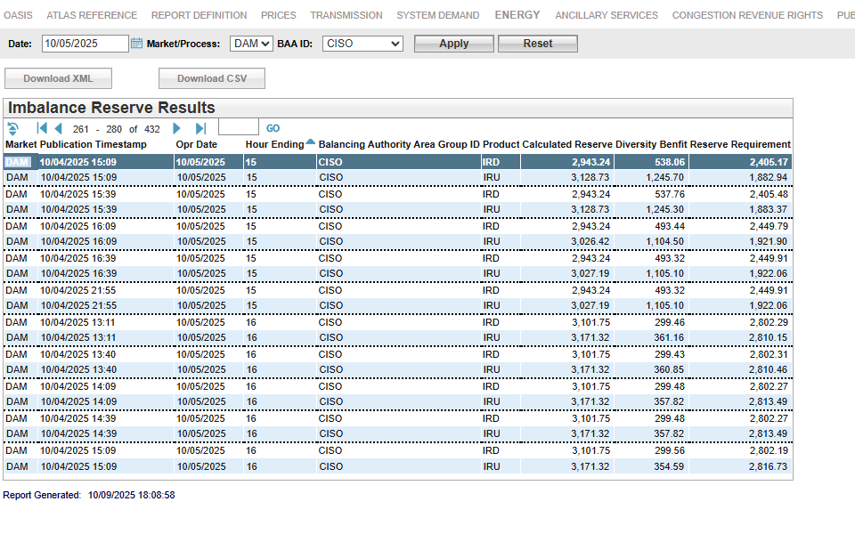
Confirm calculation of IR requirement within OASIS
Pay Attention to the Publication Timestamp.
The latest publication timestamp per day should align with Binding Forecasts as Reported on OASIS.
OASIS > Energy > Imbalance Reserve > Imbalance Reserve Results

Slide 20
Other Considerations
Putting in different scenario forecasts, with the same coefficients and other input data
Advisory values, e.g., D2 and D3 are still predicting D1 uncertainty
Calculating uncertainty (for validating performance)
*Reports not currently available in Stage and Production OASIS – results may be intermittent during market sim*

Slide 21
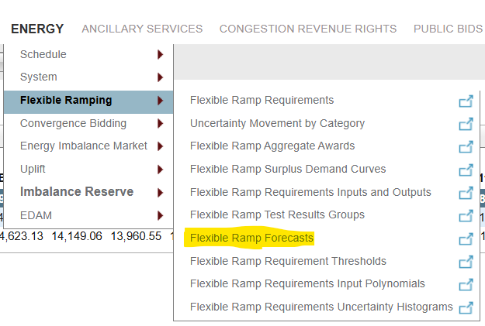
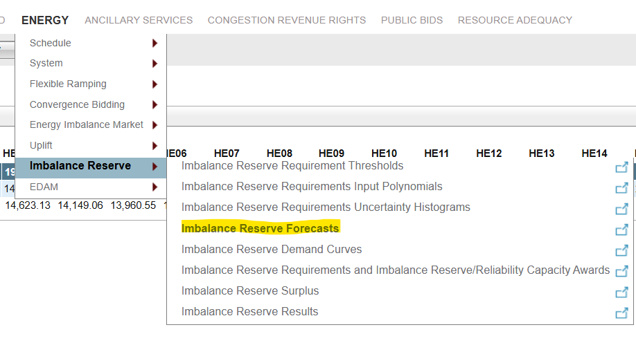
DAM Realized Uncertainty must be derived
DAM uncertainty (RTPD binding – DAM)

Slide 23
For questions, please reach out to Short-Term Forecasting via CIDI Recommended ticket details Subject: Imbalance Reserves Requirement OASIS Training Category: Forecasts
Additional references
California ISO - Imbalance Reserves Mosaic Parameter Requirements

Slide 24
Responses and Comments from 12/9 Presentation
CAISO will post an analogous presentation in pdf format for a trade date / trade hour once all reports are visible and correct
As of 12/11/2025 – “Imbalance Reserve Forecasts” report contains errant values for Wind and Solar (not representative of upstream systems)
As of 12/11/2025 – “Flexible Ramp Forecasts” report does not contain “Binding” RTPD forecasts – necessary for precise uncertainty replication
As of 12/11/2025 – “Imbalance Reserve Requirement Thresholds” report only lists “Mosaic” thresholds (e.g., Static) for HE 1 – they apply to all hours and will be changed to list for all 24 hours
Reference to reasoning around 2.5%,97.5% for IR mentioned in DAME tariff amendment filing to FERC on pg. 69 (pg. 73 of pdf)
Presenter mistakenly mentioned the downward requirement didn’t match because the “advisory” RSE result was posted instead of binding, it was the threshold logic working as designed (see changes to the spreadsheet)

Slide 25


Thank you for your participation!
For other questions or stakeholder specific questions or concerns use one of these methods:
Submit a CIDI ticket
Contact your Scheduling Coordinator
Use the “Contact us” page on caiso.com to submit questions

